Slide 1
Desk Booking Application
Bradley Allen
6th November 2023

Slide 2

The Problem – Office Attendance
Since the Covid pandemic and the working from home changes, there has been a big push to get colleagues back into the office. There are currently 2 days mandated in the office a week and from the feedback from colleagues, they don’t like not knowing where to sit, or which colleagues are in that day.
My proposal is to create a desk management app where colleagues can login from home on their personal devices and book a desk and have a view of the colleagues in the office that day.

Slide 3
Stakeholder Management
Stakeholder | Level Of Engagement | Frequency | Priority | Action Points
Operations Managers | Supportive | Monthly | Low | -Engage with department to get requirements -Engage with department to workout office seating structure
Teamleaders | Supportive | Monthly | Low | -Engage with team on preferred working days -Engage with team on WFH/Office days
Senior Leadership Team | Engagement | Quarterly | High | -Engage with SLT regarding current data WFH/Office to workout
Human Resources | Supporting Data | Monthly | Medium | -Provide data for company to workout a login system -Provide number of colleagues for scope on database required to store names -Workout a plan to update the system with joiners/leavers
Risk Team | Supporting Sign Off | Weekly | High | To ensure complicit with data protection/business risk

Slide 4
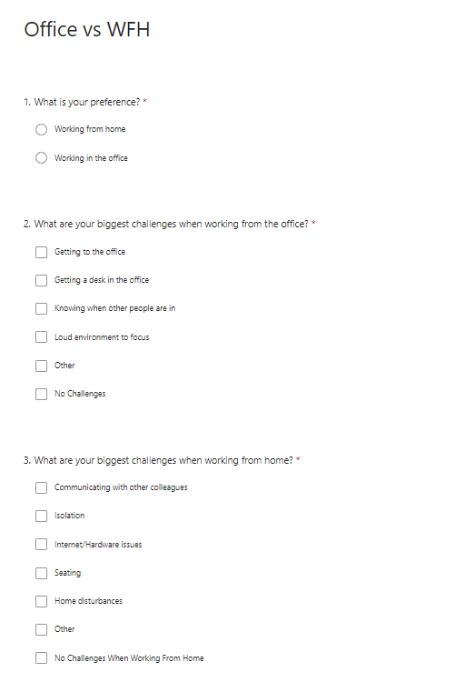
How our colleagues are feeling
We asked 1000 colleagues on their thoughts on working from home vs in the office
https://forms.office.com/Pages/ResponsePage.aspx?id=LdDQQoZiXkaZmzEAYjHvscBYfkG65fVOoYtB54GnjDJUN1JKT1VaNFNTSDhGSUU4V1MxS1Y4S1VZVi4u
60% said they preferred working from home
75% said the biggest challenge when working from the office is “Getting a desk in the office”
44% said the biggest challenge when working from the office is “Knowing when other people are in”
84% said the biggest challenge when working from home is isolation
54% said the biggest challenge when working from home was Home Disturbances
Working from the office had 10% describing no challenges vs working from home only had 3% with no challenges

Slide 5

Focus Group Initial Requirements
Our colleagues want to be able:
To book a specific desk within the office for a certain date/time
To see what days people are booked in for
To have overview of the department attendance for any given day
To keep track of their personal office attendance %
To navigate the building from one desk to another, satnav style
To have oversight of offices nationwide for away days
To be able to book for a period of time so they can have consistency with their working day

Slide 6
MoSCoW Prioritisation
Must Have
Should Have
Could Have
Will Not Have
User Login
Desk selection
Feedback Button
Accessibility features
Office Map Overview
Personal Attendance %
Teamleader overview of team attendance
Breakdown for SLT to see office attendance
Delete booking due to sickness/no longer attending
Map Zoom
Team Booking
Calendar For Office Events
Live feed of any traffic disturbances/travel delays
Change seat when already booked
Teamleader Email Confirmation Receipt
SatNav capability
Consent to book a desk on someone else’s behalf

Slide 7
Software Requirements
Functional Requirements
Non-Functional Requirements
The app must be branded and reflect Aviva’s colours/format
Desk selection in real time
Block selection on desk in use
Accessibility Features
Internet Browser
Managers should have an overview of their team
Reporting functionality
Search for desks based on location/date/availability
Security encryption to protect colleague data
Button selection to navigate the page
Floor level selection
Different Zones On Each Floor Level
Font Change ability, voice assistant
Chrome/Edge/Safari (mobile)
User friendly interface for ease of booking
Use of calendars to select dates
Scalability to accommodate business growth

Slide 8
App Wireframes – 1/4
Login Screen
Forgot Password
Desk Booking
Desk Booking
Username
What is your email?
Password
Show Details
Back To Home
Forgotten Password
Back To Home

Slide 9
App Wireframes - 2/4
Office Selection Screen
Floor Selection Screen
Select An Office
Sheffield Office - Select A Floor
Sheffield
1
Norwich
2
York
3
Manchester
London
Log Out
Go Back
Log Out

Slide 10
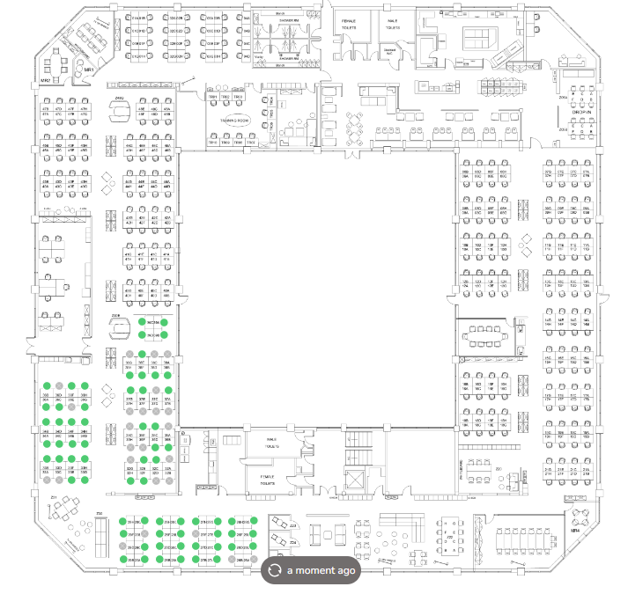

App Wireframes - 3/4
Map Example #1
Map Example #2
Eastleigh Office – Floor 1
Sheffield Office – Floor 2
Seat #001 Selected
Confirm Booking
Go Back
Log Out
Home
Log Out

Slide 11
App Wireframes - 4/4
Map Example
Confirmation Receipt Example
Error: Desk Not Booked
Desk Booked
Unable to proceed with booking, there is a chance someone has just booked this desk. Please return to the desk selection screen and try again.
I can confirm your desk has been booked at office_name on floor_number at desk #123 for 01/01/24 09:00-17:00 An email has been sent to your teamleader to notify them of your booking.
Please return Home to book further desks
OK
Home
Log Out

Slide 12
Dependencies & Requirements
• Map API – need to ensure seating is up to date
• Login database needs to be active 24/7 for ease of use
• Colleague data needs to be frequently updated to protect the business and colleagues
• Sign off from risk
• Integration with other systems such as Microsoft calendar applications within outlook/teams
• Real time data
• User authentication and permissions
• Mobile/Web compatibility
• User feedback abilities to ensure good app performance
• Notification & reminders
• Maintenance
• Scalability to ensure can keep up with business growth
• Customisation for accessibility purposes

Slide 13
Development & Deployment Process
Design Review with UX Designer
Risk Review
SLT Review & Sign Off
Code Development
SLT Review To Release For Testing
Release To 3 Teams
Release To Office
Repeat Until All Offices Are Trained

Slide 14
User Stories + Planning Poker Scores 1/3
As a user
I want to be able to see who is on the desks near me
So I can make an informed decision where I want to sit
Score
2
As a user
I want to see the current plan for my upcoming bookings
So I can plan my schedule
Score
8
As a teamleader
I want to be able to see who/where my team are sat
So I can make an informed decision when to come into the office
Score
5
As a manager
I would like to be informed on non-attendance
So I can ensure my team are following the rules of the business
Score
21
As a user
I want to be able to see who/where my team are sat
So I can make an informed decision when to come into the office
Score
5
As a user
I would like to receive notifications of my booking
So I don’t forget I’ve booked a slot
Score
5

Slide 15
User Stories + Planning Poker Scores 2/3
As a user
I want to be able to filter desks based on amenities
So I can sit near a relevant location ie close to toilets
Score
8
As a manager
I want to be able to track bookings
So I can notice any trends with team/wider business attendance
Score
55
As a user
I want to be able to provide feedback on my seating
So the business is aware of any issues to rectify any issues
Score
8
As a manager
I want to be able to assign specific desks
So I can manoeuvre my team to suit the needs of the day
Score
21
As a user
I want to be able to see who/where my team are sat
So I can make an informed decision when to come into the office
Score
5
As a user
I want to make reoccurring bookings
So I can save time booking and have consistency throughout my day.
Score
5

Slide 16
User Stories + Planning Poker Scores 3/3
As a manager
I want to be able to highlight any colleagues who haven’t attended their booking
So I can feedback and ensure it’s not a repeated action
Score
13
As a manager
I want to be able to cancel bookings
So I can amend seating should a colleague call in sick
Score
34
As a user
I want to be able to amend my booking times
So I am not wasting unused space and flexible for my role
Score
13
As a manager
I want a view of my team for the week
So I can save time navigating for individual colleagues
Score
5

Slide 17
Project Plan
Task | Jan | Feb | Mar | Apr | May | Jun | Jul | Aug | Sep | Oct | Nov | Dec
1. Planning and scoping requirements
2. Risk discussions & Sign Off
3. SLT awareness & Sign Off
4. First development
5. Release to 3 teams
6. Release To Sheffield Office
7 Release To York Office

